Slide 1
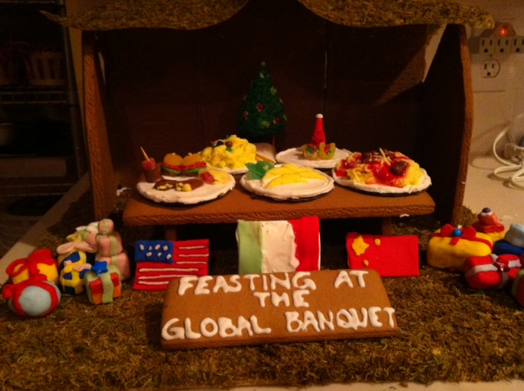
The MONTSERRAT Global Society Cluster
Global hunger banquet
Hunger Stats

Slide 2
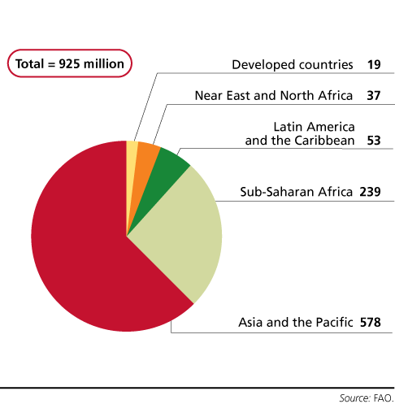
Number of hungry people in the world
Source: Food and Agriculture Organization (FAO), United Nations

Slide 3
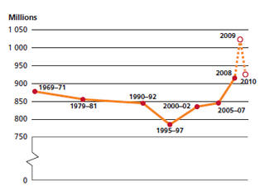
Number of hungry people, 1969-2010 (Source: FAO)
Whereas good progress was made in reducing chronic hunger in the 1980s and the first half of the 1990s, hunger has been slowly but steadily on the rise for the past decade.

Slide 4
Today, one in eight people do not get enough food to be healthy and lead an active life, making hunger and malnutrition the number one risk to health worldwide.
(Source: World Food Programme, WFP)

Slide 5
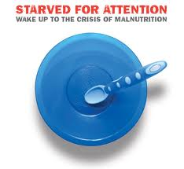
Foodless days are now a part of life for up to 24 percent of families in India, 27 percent in Nigeria, and 14 percent in Peru. (Source: Save the Children)

Slide 6
Malnutrition causes a range of problems, such as being dangerously thin, being too short for one's age, being deficient in vitamins and minerals (such as lacking iron which makes you anaemic), or even being too fat (obese). (Source: WFP)

Slide 7
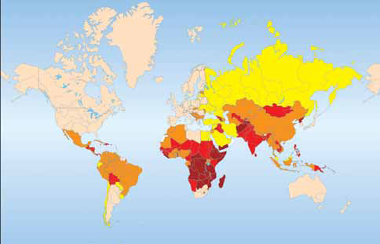
Number of people
under-nourished in
% of total population
PINK: up to 2.5 %
YELLOW: 2.5-4 %
BROWN: 5-19 %
RED: 20-34 %
MAROON: 35 % and more
(Source: Caritas Switzerland, WFP and FAO)

Slide 8
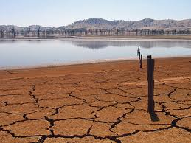
Climate change is increasingly viewed as a current and future cause of hunger and poverty. Increasing drought, flooding, and changing climatic patterns require a shift in crops and farming practices that may not be easily accomplished. (Source: World Hunger Education Services)

Slide 9
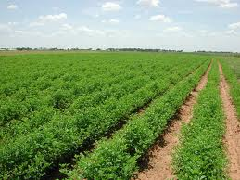
The world produces enough food to feed everyone. World agriculture produces 17 percent more calories per person today than it did 30 years ago, despite a 70 percent population increase. (Source: FAO)

Slide 10
In developing countries, almost one out of every 15 children will die before they reach the age of five. (Source: UNICEF)

Slide 11
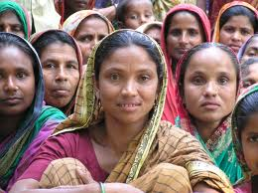
Women make up a little over half of the world's population, but they account for over 60 percent of the world’s hungry. (Source: ECOSOC, United Nations)

Slide 12
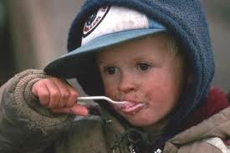
Ten percent of American households were not able to provide their children with “adequate, nutritious” food at times during 2011. This translates into more than 16.6 million children — or 22 percent of all American kids.
(Source: US Department of Agriculture, USDA)

Slide 13
A new AARP Foundation study shows that nearly 9 million older adults in the United States face the risk of hunger – meaning they are forced to skip meals or buy poor quality food. (Source: American Association of Retired Persons, AARP)

Slide 14
Worcester Hunger Statistics
1 in 3 children living in 14 low-income neighborhoods in Worcester are hungry or at-risk of being hungry each month. 20.9% of families in Worcester live below the poverty level. 72% of children in Worcester Public Schools are eligible for free or reduced-cost meals. 32% of surveyed mothers not living in shelters stated there were days last month when family members went without food. (Source: Rachel’s Table)

Slide 15
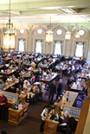
HOLY CROSS FOOD STATS Reductions in food waste over a six-month period after the elimination of trays in Kimball Dining Hall: 41,122 pounds in food waste 5,874 gallons in liquid waste 234,987 gallons in water usage (Source: Holy Cross Magazine)

